Slide 1
Investigating the Power Efficiency of Numerical Software
Siddharth Chandrashekar

Slide 2
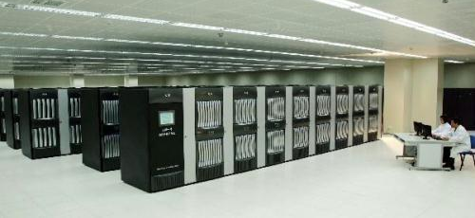
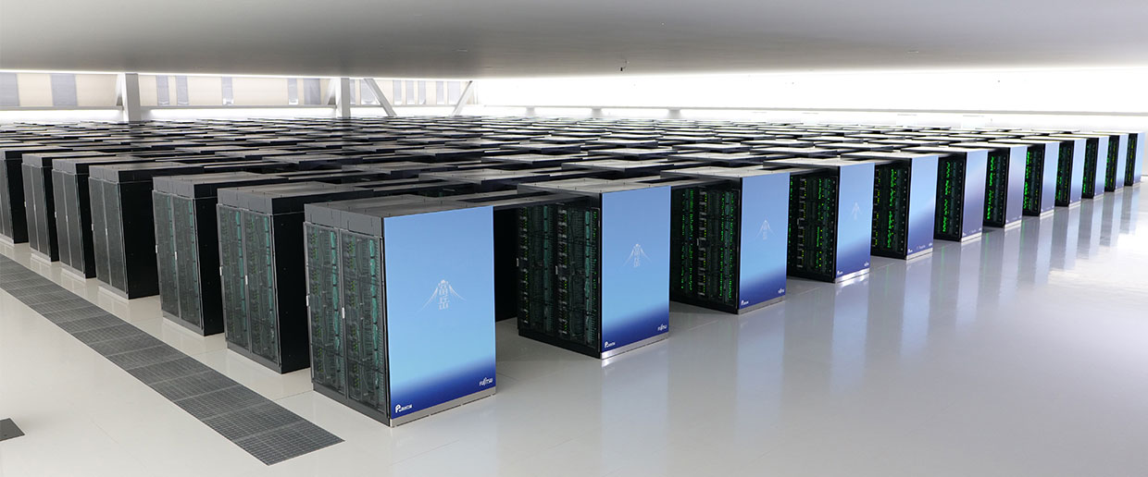
The Growing Importance of Energy Efficiency
Supercomputers are an essential part of our lives. Naturally over the years, we have demanded better performance.
Supercomputer consume more power than ever before.
This leads to a major cost for system owners but it is also has a major environmental impact.
Tianhe-1A (2010) [1]
Fugaku (2020) [2]

Slide 3
What is being done?
Chips are constantly providing better performance while using less power.
Green500 incentivises building supercomputers to be more efficient and recognizing them for it.
In 2009 the Energy Efficient High Performance Computing Working Group (EE HPC WG) [3] was formed. Now with 700 members from 25 countries, they work to create more power efficient HPC systems.

Slide 4
Project Proposal
Investigate the impact of optimisations on the power consumption of numerical code
Main focus is on Conjugate Gradient Method using the HPCG benchmark [4] for testing. A key kernel of CG is Sparse Matrix Vector Multiplication.
The concept that is being targeted is moving data in memory, this will have a definite impact on power consumption.

Slide 5
Possible Methods for Improvement
Investigate the impact of running the benchmark with MPI, openMP and hybrid MPI/openMP.
Implement the Matrix-free method, generally used for performance optimisation.
Minimises loads from memory
Implement different data layouts, HPCG, by default uses a format similar to Compressed Row Storage (CRS). Investigate the performance of SELL-C-σ.

Slide 6
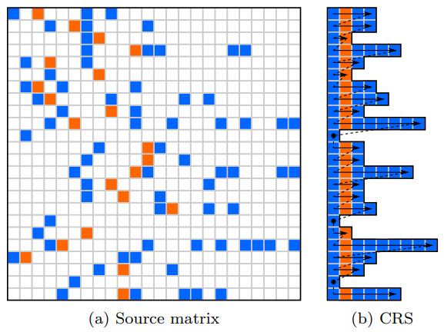
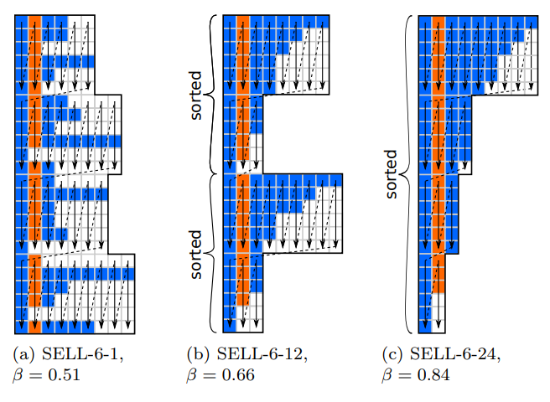
Sell-C-σ
Visual representation of matrix storage layouts [5]

Slide 7
Resources Needed
Machines that can take power readings: Fulhame (Tx2Mon package) and NextgenIO. Access to both machines has been acquired
Archer2’s CrayPat profiler can also be used if machines become unavailable. Access would need to be requested.

Slide 8
Success Criteria
Investigate impact of optimisation on power consumption running numerical code:
User Level: MPI/openMP/hybrid
Application Level: Matrix-free method
Library Level: Data format (Sell-C-σ)
Identify which stakeholder has the most impact on power consumption. To guide future software development.

Slide 9
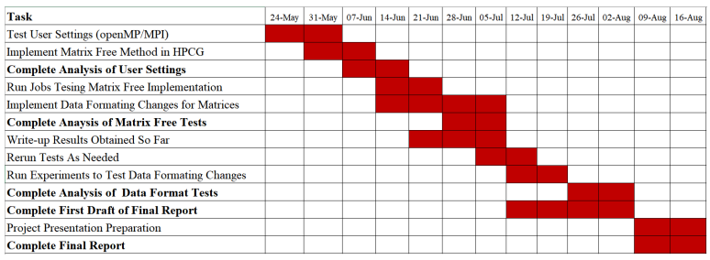
Timeline

Slide 10
Fallbacks
There are two separate machines for running experiments, in case one of the machines becomes unavailable.
If there are no machines available for measuring power consumption, then the project can pivot to measuring performance impact.
There are a few different methods to investigate so the plan is ordered by expected difficulty and time required.
Fallback position would be just user and application level optimisations.

Slide 11
Preliminary results – Cache Levels
Impact on speed as problem size increased on 1 process

Slide 12
Preliminary Results – Memory Energy Consumption
Energy used during 60s of running HPCG when problem size is increasing on 64 processes(parallel)

Slide 13
Preliminary Results – Memory Energy Consumption
Energy used during 60s of running HPCG when problem size is increasing on 1 process (serial)

Slide 14
Conclusion
Demonstrated the setup can measure power consumption for both serial and parallel runs.
The preliminary experiments show that when the problem is primarily held in cache, the energy consumption is lower.
Optimising for cache should lead to lower energy consumption.

Slide 15
References
[1] “China's Tianhe-1A becomes world's fastest computer” http://www.china.org.cn/video/2010-11/18/content_21372263.htm
[2] “Japan’s Fugaku Supercomputer Completes First-Ever Sweep of High-Performance Benchmarks” https://spectrum.ieee.org/tech-talk/computing/hardware/japans-fugaku-supercomputer-is-first-in-the-world-to-simultaneously-top-all-high-performance-benchmarks
[3] Laura Panjwani (2018) “Green Supercomputing: Why Energy Efficiency is Just as Key as Performance in HPC” – R&D world
[4] https://www.hpcg-benchmark.org
[5] Kreutzer et. al (2014). A unified sparse matrix data format for efficient general sparse matrix vector multiply on modern processors with wide SIMD units.

